Slide 1

Second Metadata Improvement Lab at ESIP: Leveraging Jupyter in Anaconda and Web Services for user initiated metadata evaluation
Sean Gordon
(scgordon@hdfgroup.org)
The HDF Group

Slide 2
Overview
Welcome to the second MILE. In this summer’s lab, we’ll use Anaconda to provide a scientific data computing platform. We’ll employ Python 3.6 and BASH in Jupyter Notebooks to create a package from your own metadata, upload it to an evaluator Web Service, and receive a csv data table. This data can be used in a variety of analyses, including the Recommendations Analysis Dashboard we learned how to use in the first MILE, last year in Raleigh, NC.
Let’s begin. Go to http://github.com/scgordon/MILE2/wiki

Slide 3
MILE2 Wiki

Slide 4
Download Anaconda with Python 3.6
Go to

Slide 5
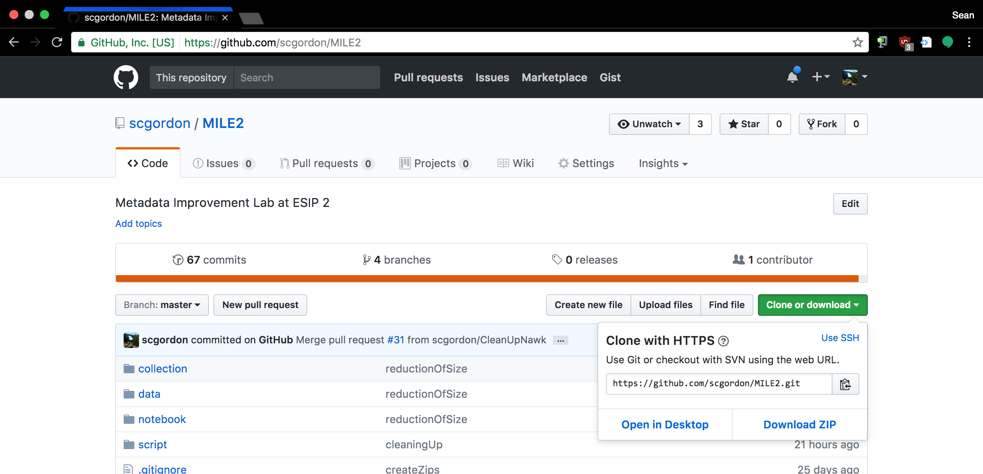
Download the MILE2 GitHub Directory
The quickest way is to download the zip file of the directory, then unzip it. Your default download location

Slide 6
Install Anaconda with Python 3.6
Go to

Slide 7
Initialize our open data scientific computing platform
Once you’ve started Anaconda, select Jupyter Notebooks, and navigate to the MILE2 directory.
Select Metadata2Data.ipynb to start the notebook that prepares metadata to be bundled and uploaded to the evaluator.

Slide 8
A Quick Disclaimer
I am not a computer scientist.
NASA. (Unknown date). Margaret Hamilton, lead Apollo flight software engineer, in the Apollo Command Module.
Retrieved from https://commons.wikimedia.org/wiki/File:Margaret_Hamilton_in_action.jpg
Notes:
I was not trained in many of the basic concepts and styles of programming. So while for some of you this may be more technical than you are used to, others here are looking at the code like…

Slide 9
Oh, so this is a Spaghetti Western
Gefangenen, R. (2007, February 27). Blondie.
Retrieved July 18, 2017, from https://c1.staticflickr.com/1/177/403475732_65dc0af0d0_b.jpg

Slide 10
Well, get along little doggies
Notebook navigation
Difference between markup and code cells
While BASH and Python are used in the notebooks, this lab is not intended to teach either.
The point is to get familiar with the Jupyter Notebooks environment and to be able to initiate the Evaluator webservice so that it becomes possible to

Slide 11
Lets evaluate some metadata!

Slide 12
Types of Analysis you can try today
Create Recommendations Analysis Dashboard data
Look at the content of specific concepts and the frequency at which that content value is used throughout the collection to identify opportunities for
Identify potential dialect definitions for unknown concepts
Combine multiple results from the evaluator and compare concept frequency across collections and dialects.

Slide 13

Questions?
Thank you!
Thank You!

